Slide 1
Execution Environment Virtualization

Slide 2
Learning Outcomes
LO2: LO2: (C3) Application: Construct Infrastructure as Code (IaC) templates and Docker configurations to automate the deployment of cloud-native environments. : Analyze system requirements to identify actors, processes, data, and interactions
LO 4 : Apply UML-based design artifacts to communicate a complete system solution

Slide 3
Outline
CPU Instruction Sets
Binary Translation
Ring Architectures
Hardware-Assisted Virtualization (VT-x / AMD-V)
Trap-and-Emulate

Slide 4
CPU Instruction Sets

Slide 5
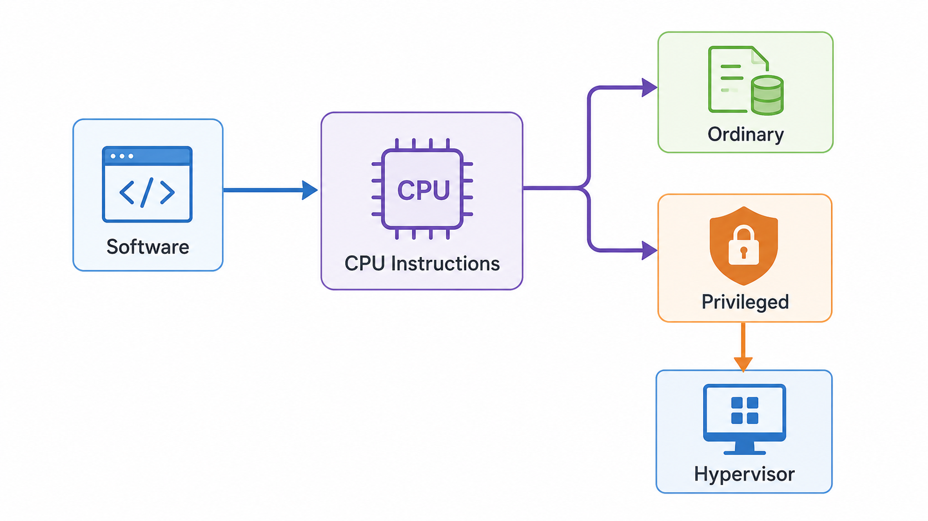
CPU Instruction Sets
CPU Instruction Sets
Software runs as CPU instructions
Instructions define what the processor should do
Some instructions are ordinary operations
Some instructions require privileged access
Virtualization must control privileged instruction execution
Notes:
Every software program eventually runs as a set of CPU instructions. These instructions tell the processor what operations to perform, such as calculating values, moving data, or accessing system resources. In a normal computer system, ordinary instructions can be executed by applications, while privileged instructions are reserved for the operating system because they control hardware or system-level resources. In virtualization, this becomes important because a guest operating system may try to execute privileged instructions, but the hypervisor must manage them safely.

Slide 6

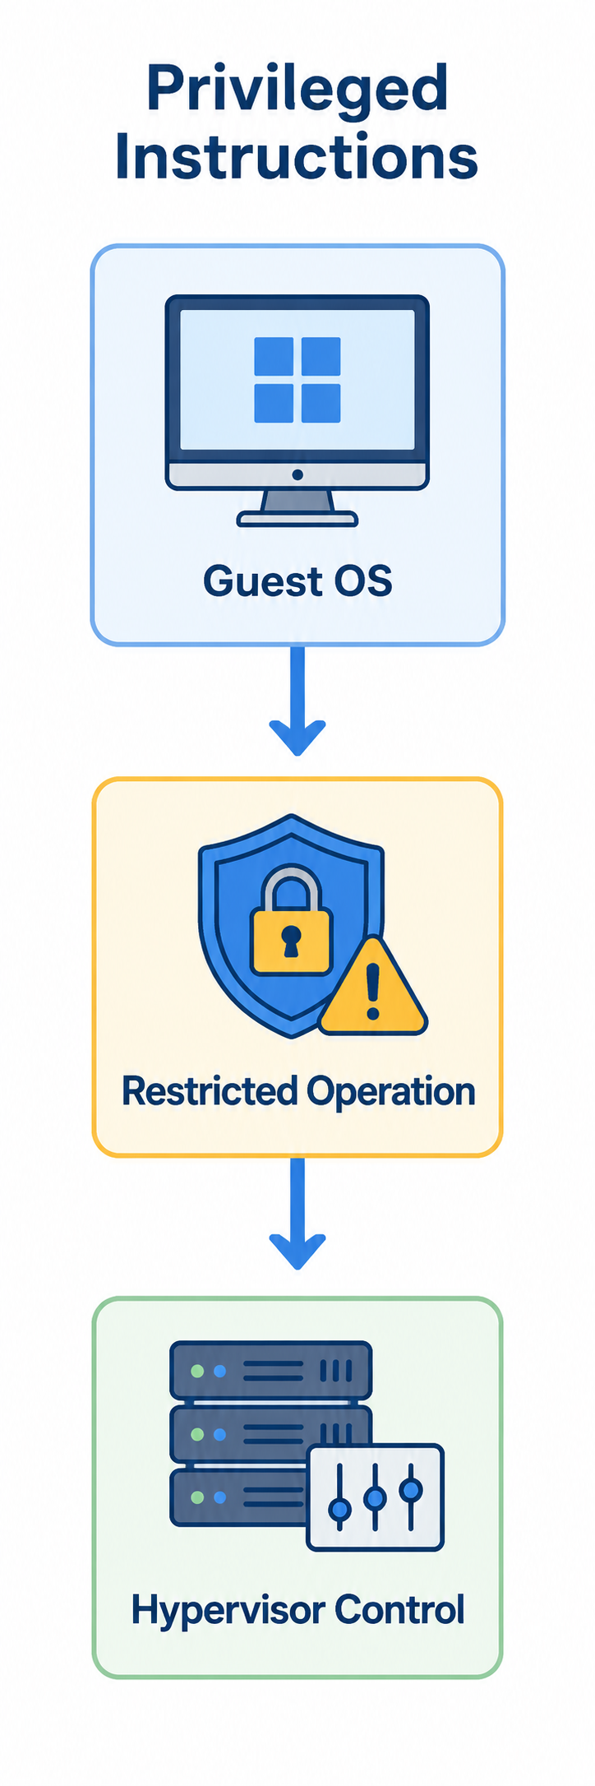
CPU Instruction Sets
Types of Instructions
Non-privileged Instructions | Priviliged Instructions
Run un user mode | Require higher access rights
Used by normal applications | Used by operating systems
Safe for ordinary operations | Control hardware and system resources
Virtualization Challenge
Guest OS expects hardware access
Hypervisor must control privileged operations
Notes:
CPU instructions can be divided into non-privileged and privileged instructions. Non-privileged instructions are ordinary operations that can be executed by normal applications in user mode, such as calculations or simple data movement. Privileged instructions require higher access rights because they can control hardware, memory, I/O devices, or other system-level resources. In a virtualized environment, the guest operating system may expect to access these privileged operations directly, but the hypervisor must control them to keep the system safe and isolated.

Slide 7
Binary Translation

Slide 8
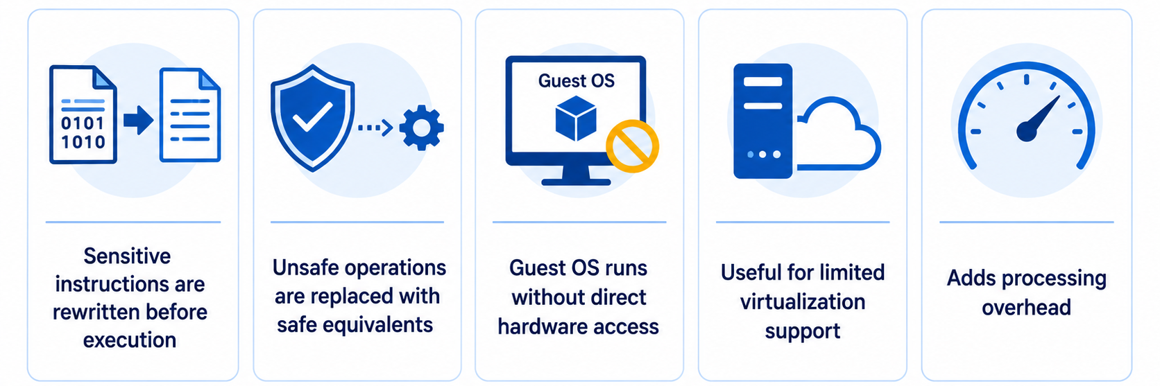
Binary Translation
Binary Translation
Notes:
Binary translation is a software-based virtualization technique. Instead of allowing all guest operating system instructions to run directly on the hardware, the virtualization layer examines the instruction stream and rewrites sensitive or unsafe instructions into safe alternatives before execution. This allows the guest OS to run as if it had hardware access, even though the hypervisor is still in control. Binary translation was especially important for architectures that were not easily virtualizable, but it comes with additional overhead because instructions must be analyzed and translated.

Slide 9
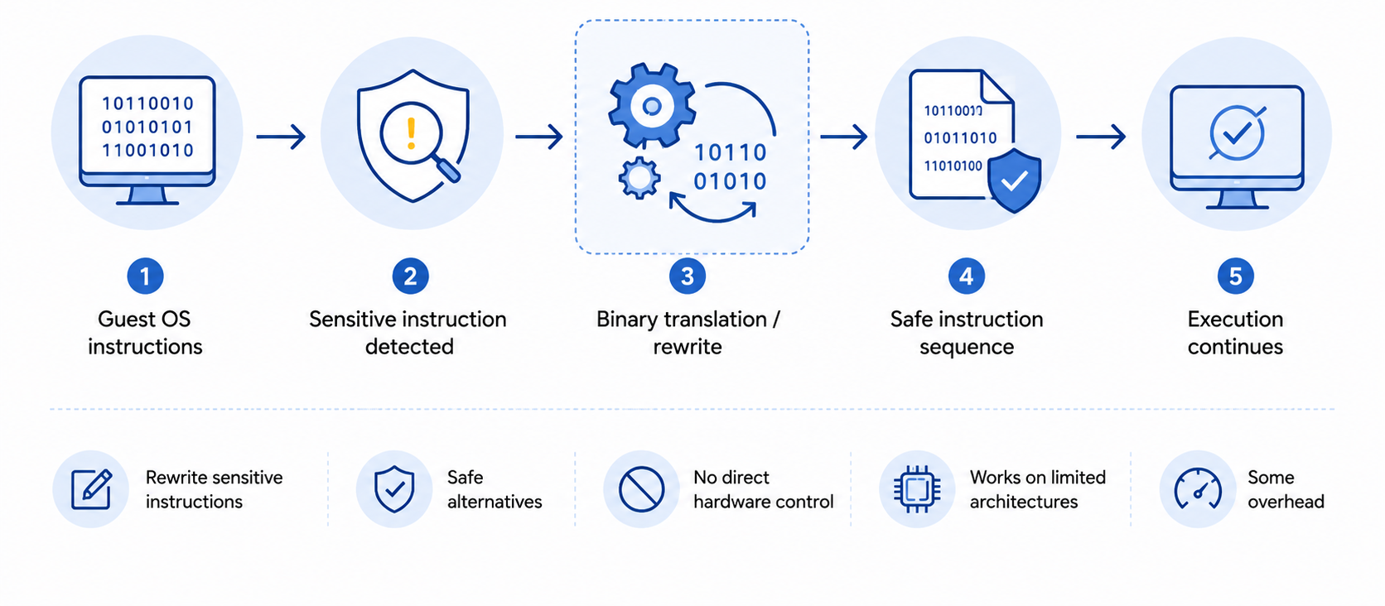
Binary Translation
How Binary Translation Works
Notes:
Binary translation is used to handle sensitive instructions in a virtualized system. The guest OS sends instructions as if it had direct access to the hardware. When sensitive or privileged instructions are detected, the hypervisor rewrites them into safe instruction sequences. The translated code is then executed safely on the CPU or virtualized hardware. As a result, the guest OS can continue running normally, while the hypervisor still maintains control over hardware access.

Slide 10
Ring Architectures

Slide 11
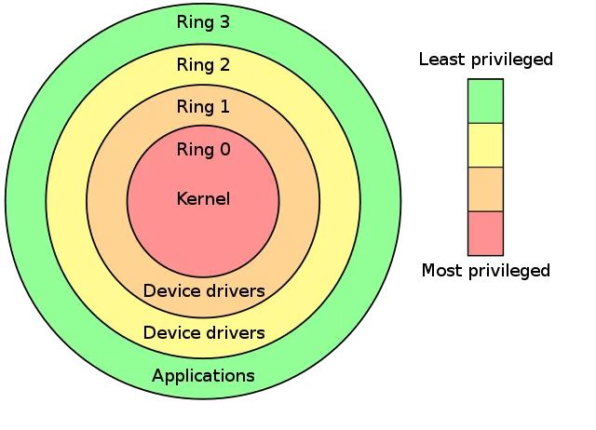
Ring Architectures
Ring Architectures
CPUs use privilege levels called rings
Ring 0 has the highest privilege
Operating systems usually run in Ring 0
Applications usually run in Ring 3
Privilege rings control access to hardware and system resources
Virtualization changes how these privilege levels are managed
Image retreived from: https://medium.com/@ciber.jc.ss/what-are-the-rings-of-the-x86-architecture-fb66322358e0
Notes:
Ring architecture is a CPU protection model that separates software execution into different privilege levels. The most privileged level is Ring 0, which is normally used by the operating system kernel because it needs direct access to hardware, memory, and system resources. Applications usually run in Ring 3, which has lower privilege and cannot directly control the hardware.
This separation helps protect the system. If an application wants to perform a sensitive operation, it must request the operating system to do it on its behalf. In virtualization, this model becomes more complex because the guest operating system expects to run with high privilege, but the hypervisor also needs to maintain control over the actual hardware. Because of this, virtualization changes how privilege levels are managed.

Slide 12
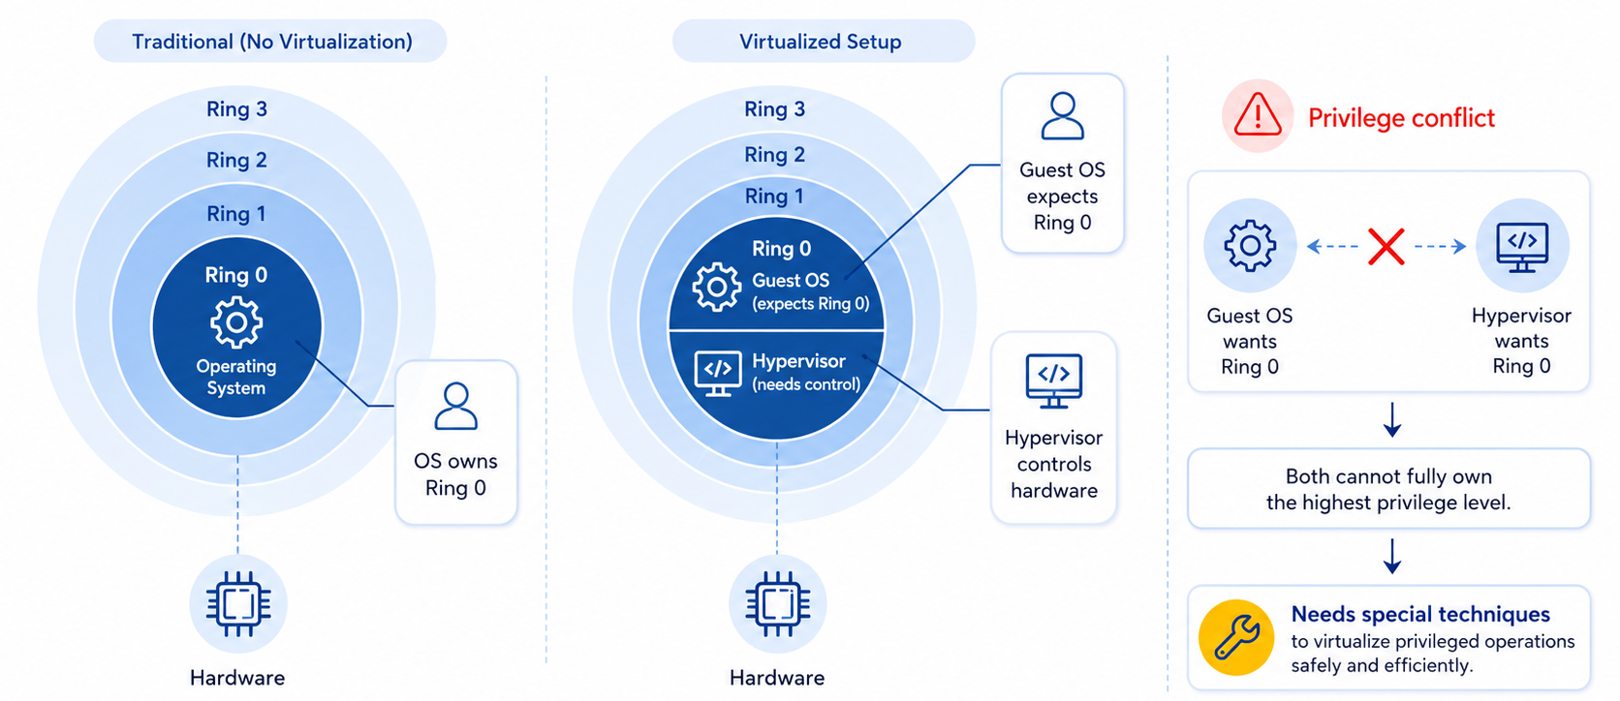
Ring Architectures
Ring Problem in Virtualization
Notes:
In a traditional system, the operating system kernel expects to run in Ring 0 because it needs the highest privilege to manage hardware, memory, and system resources. However, in a virtualized environment, the guest operating system also expects to run as if it fully controls the machine.
The problem is that the hypervisor must also maintain strong control over the real hardware. Both the guest OS and the hypervisor cannot fully own the same highest privilege level at the same time. This creates a conflict in classic virtualization, because the guest OS may try to execute privileged instructions directly.
To solve this problem, virtualization systems use special techniques. Some systems use binary translation to rewrite unsafe instructions. Others use trap-and-emulate or hardware-assisted virtualization so the hypervisor can safely intercept and manage privileged operations.

Slide 13
Hardware-Assisted Virtualization (VT-x / AMD-V)

Slide 14
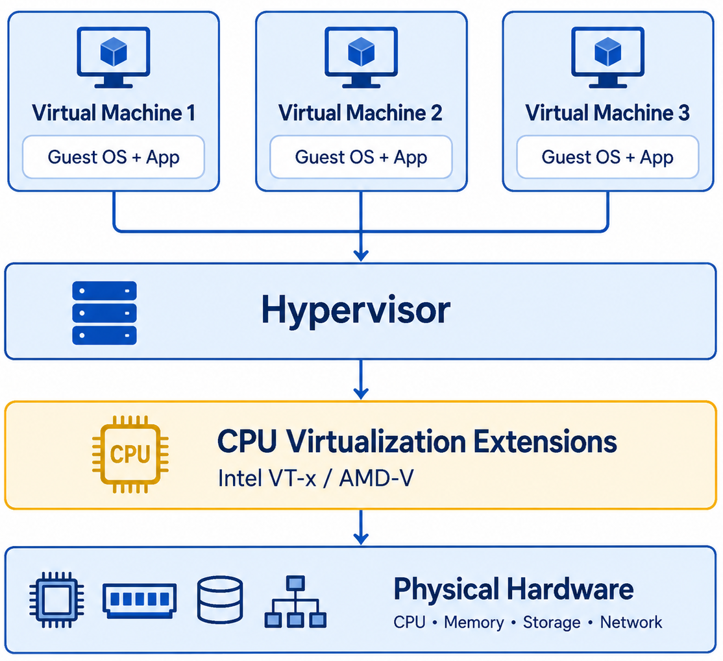
Hardware-Assisted Virtualization (VT-x / AMD-V)
Hardware-Assisted Virtualization
Modern CPUs include built-in virtualization support
Examples: Intel VT-x and AMD-V
Helps the hypervisor manage guest operating systems
Reduces reliance on software-only virtualization techniques
Improves performance, isolation, and control
Notes:
Hardware-assisted virtualization is a virtualization approach where the processor itself provides special features to support virtual machines. Modern CPUs include virtualization extensions such as Intel VT-x and AMD-V. These features help the hypervisor manage guest operating systems more efficiently, especially when dealing with privileged instructions and hardware access.
Before hardware-assisted virtualization became common, virtualization systems often relied on software techniques such as binary translation. These techniques worked, but they could be complex and introduce performance overhead. With CPU-level virtualization support, the hypervisor can handle guest operating systems more directly and safely. This improves performance, strengthens isolation, and makes virtualization more practical for modern cloud platforms.

Slide 15
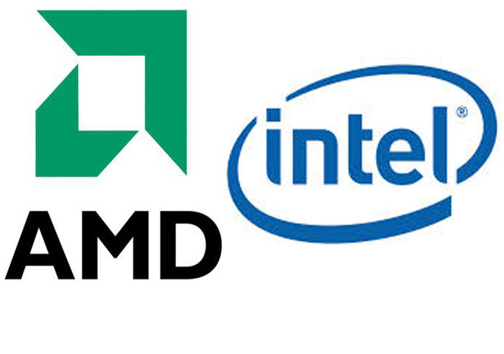
Hardware-Assisted Virtualization (VT-x / AMD-V)
Why This is matter
Better handling of privileged instructions
More efficient than binary translation alone
Stronger separation between guest OS and hardware
Easier hypervisor implementation
Common in modern virtual machines and cloud platforms
Image retreived from: https://winpoin.com/intel-bocorkan-core-i7-baru-dengan-grafik-radeon-rx-vega/
Notes:
Hardware-assisted virtualization is a virtualization approach where the processor itself provides special features to support virtual machines. Modern CPUs include virtualization extensions such as Intel VT-x and AMD-V. These features help the hypervisor manage guest operating systems more efficiently, especially when dealing with privileged instructions and hardware access.
Before hardware-assisted virtualization became common, virtualization systems often relied on software techniques such as binary translation. These techniques worked, but they could be complex and introduce performance overhead. With CPU-level virtualization support, the hypervisor can handle guest operating systems more directly and safely. This improves performance, strengthens isolation, and makes virtualization more practical for modern cloud platforms.

Slide 16
Hardware-Assisted Virtualization (VT-x / AMD-V)
Intel VT-x vs AMD-V
Intel VT-x | AMD-V
Virtualization extension from Intel CPUs | Virtualization extension from AMD CPUs
Helps hypervisors run guest operating systems | Provides similar hardware support for virtualization
Supports efficient handling of privileged operations | Helps isolate virtual machines from physical hardware
Common in Intel-based servers and cloud infrastructure | Common in AMD-based servers and cloud infrastructure
Key Point
Different vendors, similar purpose
Both help improve VM performance, isolation, and control
Notes:
Intel VT-x and AMD-V are hardware virtualization technologies provided by different CPU vendors. VT-x is Intel’s virtualization extension, while AMD-V is AMD’s equivalent technology. Although they come from different processor families, their purpose is similar: they help the hypervisor manage guest operating systems more efficiently.
Both technologies improve how privileged operations are handled in virtual machines. Instead of relying only on software techniques such as binary translation, the CPU provides built-in support for virtualization. This helps reduce overhead, improve isolation, and make virtual machines more practical for modern servers and cloud platforms.
The key takeaway is that VT-x and AMD-V should not be seen as completely different concepts. They are vendor-specific implementations of the same broader idea: hardware-assisted virtualization.

Slide 17
Trap-and-Emulate

Slide 18
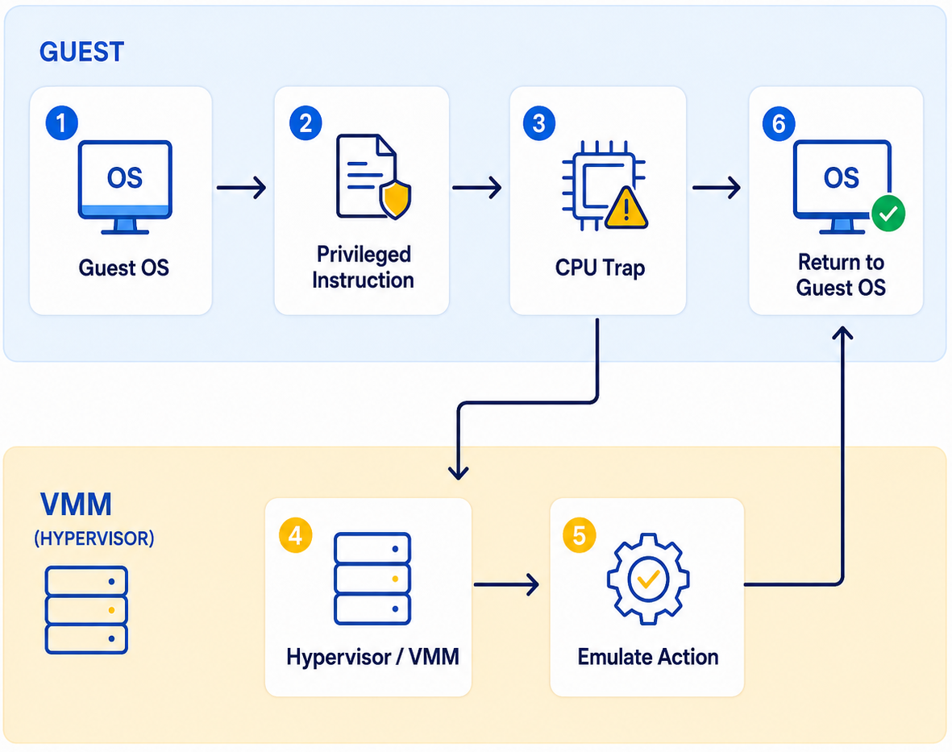
Trap-and-Emulate
Trap-and-Emulate
Guest OS executes a privileged instruction
CPU detects the restricted operation
The instruction triggers a trap
Control is passed to the hypervisor
Hypervisor emulates the expected result
Execution returns to the guest OS
Notes:
Trap-and-emulate is a virtualization technique used to handle privileged instructions safely. In a normal system, the operating system may execute privileged instructions directly because it controls the hardware. However, in a virtualized environment, the guest operating system cannot be allowed to directly control the physical hardware.
When the guest OS attempts to execute a privileged instruction, the CPU detects that the operation requires higher privilege. This causes a trap, which transfers control from the guest OS to the hypervisor. The hypervisor then emulates the expected result of that instruction in a safe way. After the operation is handled, execution returns to the guest OS, so the guest system can continue running as if the instruction had been executed normally.

Slide 19
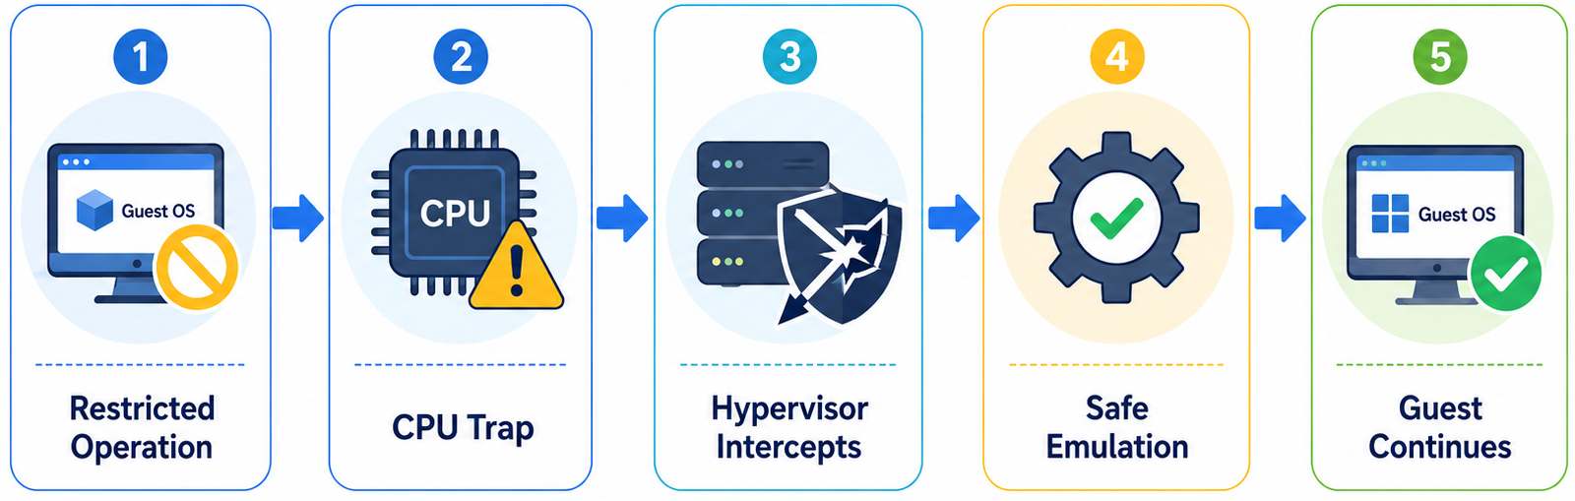
Trap-and-Emulate
Trap-and-Emulate Process
Notes:
Trap-and-emulate works as a controlled execution process. First, the guest system attempts to perform a restricted operation, such as accessing hardware or executing a privileged instruction. Because the guest OS should not directly control the hardware, the CPU automatically generates a trap.
After the trap occurs, control is transferred to the hypervisor. The hypervisor inspects the action and performs a safe emulation of the expected result. This allows the system to preserve the behavior expected by the guest OS while still protecting the real hardware. Once the emulation is complete, the guest OS continues execution without direct hardware access.

Slide 20
Summary
Virtualization requires control over CPU execution
Privileged instructions create key virtualization challenges
Binary translation rewrites unsafe instructions
Ring architectures explain privilege conflicts
VT-x / AMD-V and trap-and-emulate improve virtualization support
Notes:
Trap-and-emulate is a virtualization technique used to handle privileged instructions safely. In a normal system, the operating system may execute privileged instructions directly because it controls the hardware. However, in a virtualized environment, the guest operating system cannot be allowed to directly control the physical hardware.
When the guest OS attempts to execute a privileged instruction, the CPU detects that the operation requires higher privilege. This causes a trap, which transfers control from the guest OS to the hypervisor. The hypervisor then emulates the expected result of that instruction in a safe way. After the operation is handled, execution returns to the guest OS, so the guest system can continue running as if the instruction had been executed normally.

Slide 21
Exercise
When a Guest OS inside a VM tries to execute a privileged instruction, why must the hardware trap to the hypervisor rather than letting the Guest OS handle it directly?

Slide 22
References
Erl, T., & Barceló Monroy, E. (2024). Cloud computing: Concepts, technology, security & architecture. Pearson.
Katzer, J. (2021). Learning serverless: Design, develop, and deploy with confidence. O’Reilly Media.
Marinescu, D. C. (2022). Cloud computing: Theory and practice (3rd ed.). Elsevier.
Notes:
Trap-and-emulate is a virtualization technique used to handle privileged instructions safely. In a normal system, the operating system may execute privileged instructions directly because it controls the hardware. However, in a virtualized environment, the guest operating system cannot be allowed to directly control the physical hardware.
When the guest OS attempts to execute a privileged instruction, the CPU detects that the operation requires higher privilege. This causes a trap, which transfers control from the guest OS to the hypervisor. The hypervisor then emulates the expected result of that instruction in a safe way. After the operation is handled, execution returns to the guest OS, so the guest system can continue running as if the instruction had been executed normally.

